Slide 1
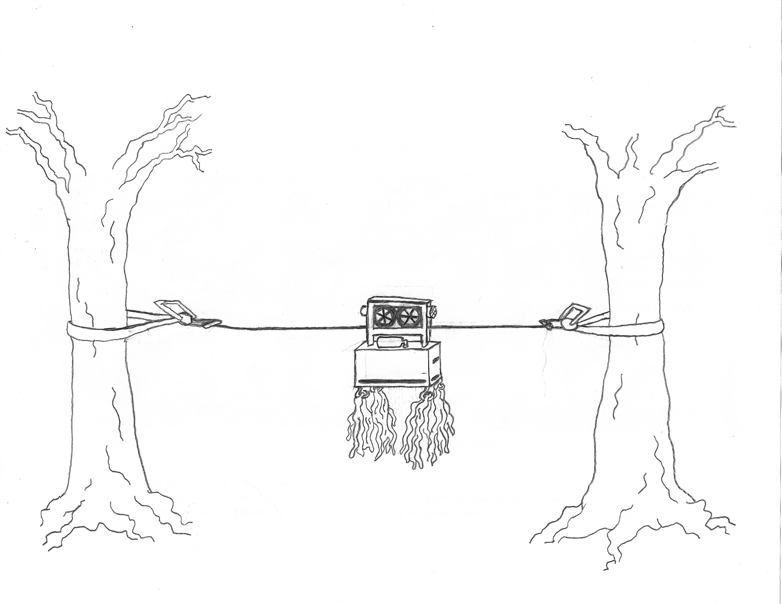

Mobile Tick Trap Design Review
The Ticked-off Team
Edward Kelly, Orion Kalt, Patrick Duong, In Plaskett, Zachary Konieczka
November 12
ENGR 151: Introductory Design and Computing

Slide 2
Design Constraints (Updated)
Constraint Name | Description
Live ticks | The trap must keep the caught ticks alive
Design integration | Our model must integrate with the work of the previous groups
Arduino hardware | Digital, analog, and GND pins are needed
Height | Our model must stay off the ground
Power source | Must run on portable/ available power source
Durability | The system must be able to survive outdoor weather and animals that could possibly come into contact with it.

Slide 3
Design Objectives (Updated)
Objective Name | Description
Adjustable height | The system is able to move up and down.
CO2 | We must have enough CO2 for at least one week before replacement
Aesthetic | The model should look nice and have a user-friendly structure. Set up should be intuitive.
Mobility | Design should have a mobility range of 10 or more feet
Visibility | The design should be visible to people or animals.
Responsive | Our model should use sensors to move back and forth between two points, and turn back if an obstacle is encountered.
Objective | Description

Slide 4
Project Concept Statement
- The mobile tick trap is designed to collect living ticks for research. Adding mobility to the tick trap will be accomplished with motorized wheels mounted on the tick trap with stainless steel cable strung between ratchet straps wrapped around trees.
- Nature will provide a multitude of possible obstructions which we hope to detect with motion sensors and switches.
- This project will generate valuable knowledge for the little understood prevalence of ticks in the Pacific Northwest.

Slide 5
Design Concept
Ratchet Straps
Tick Mop
Cable
Tick Tram

Slide 6
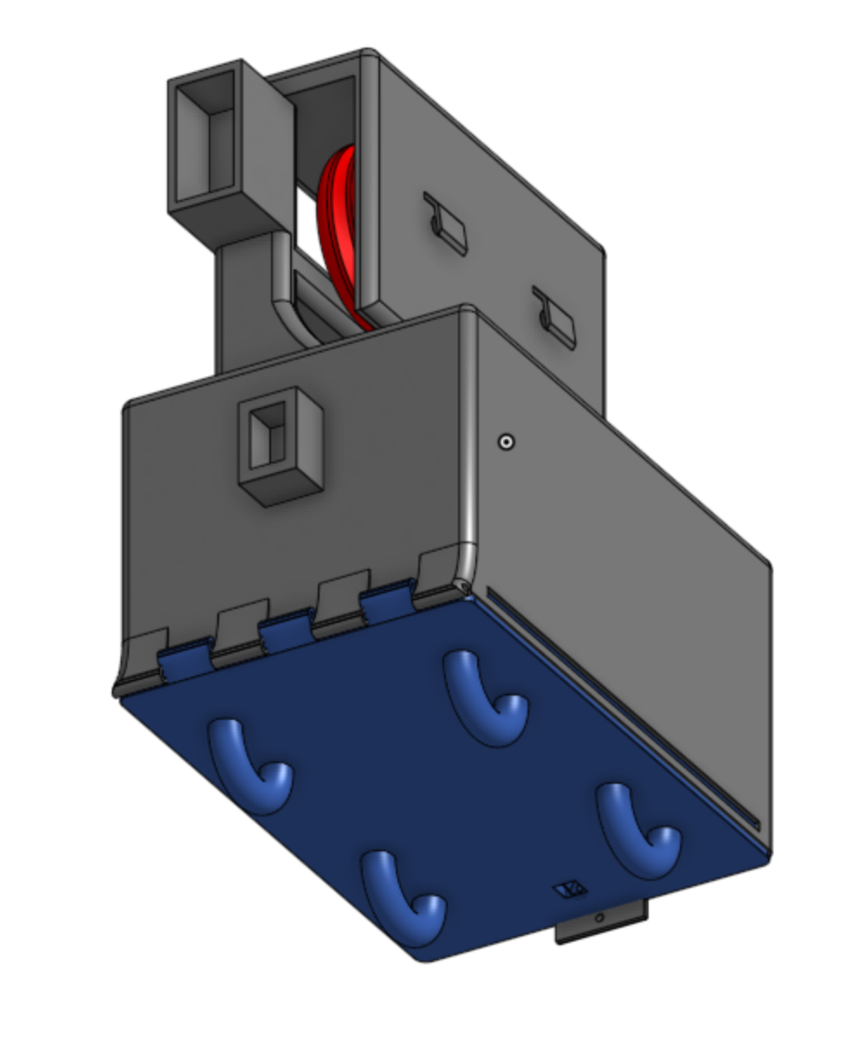
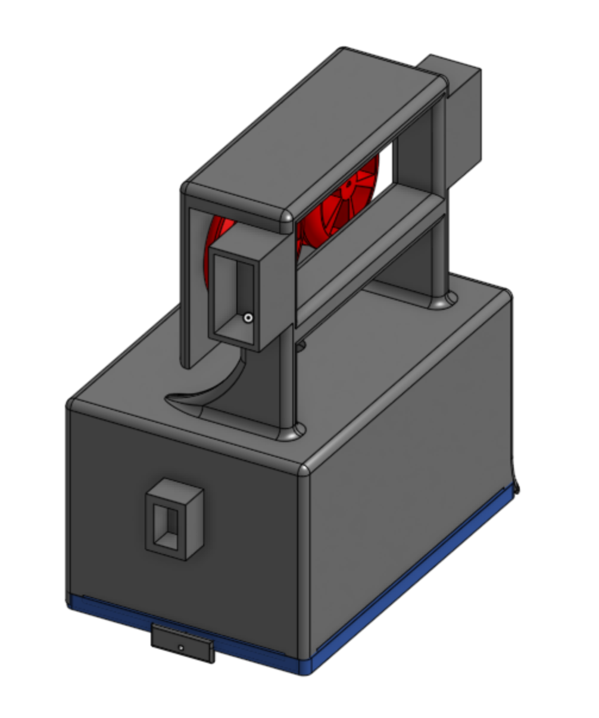
Design Concept
Sensor housing
Wheel System and Motor housing
Bump Switch housing
Loops to hang mop

Slide 7
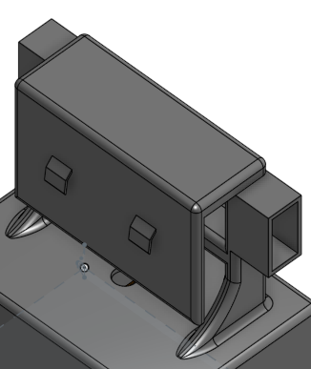
Key Features: Ultrasonic Sensors
Sensor housing
Attached to the front and back of trap above wire attachment
Support the mobility of the trap by telling it when to turn around
Mounted above wire so it's less likely to notice small obstructions that won’t impede mobility

Slide 8
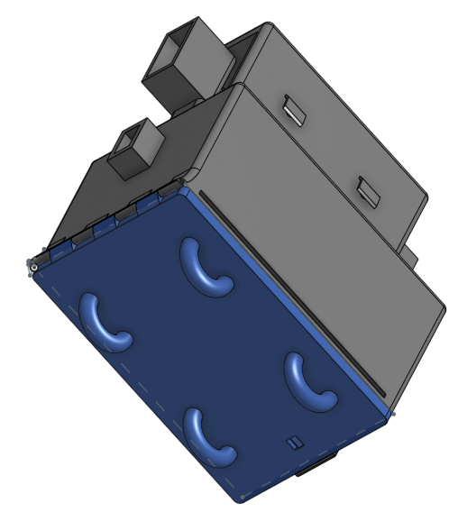
Key Features: Mop and Loops
Located at the bottom of the trap, kept by 4 loops. Helps the trap to catch more ticks within its reach.
Visible enough for people and animals to avoid crashing into the trap (support the visibility of the trap).
Dragged around to catch ticks.
Loops

Slide 9
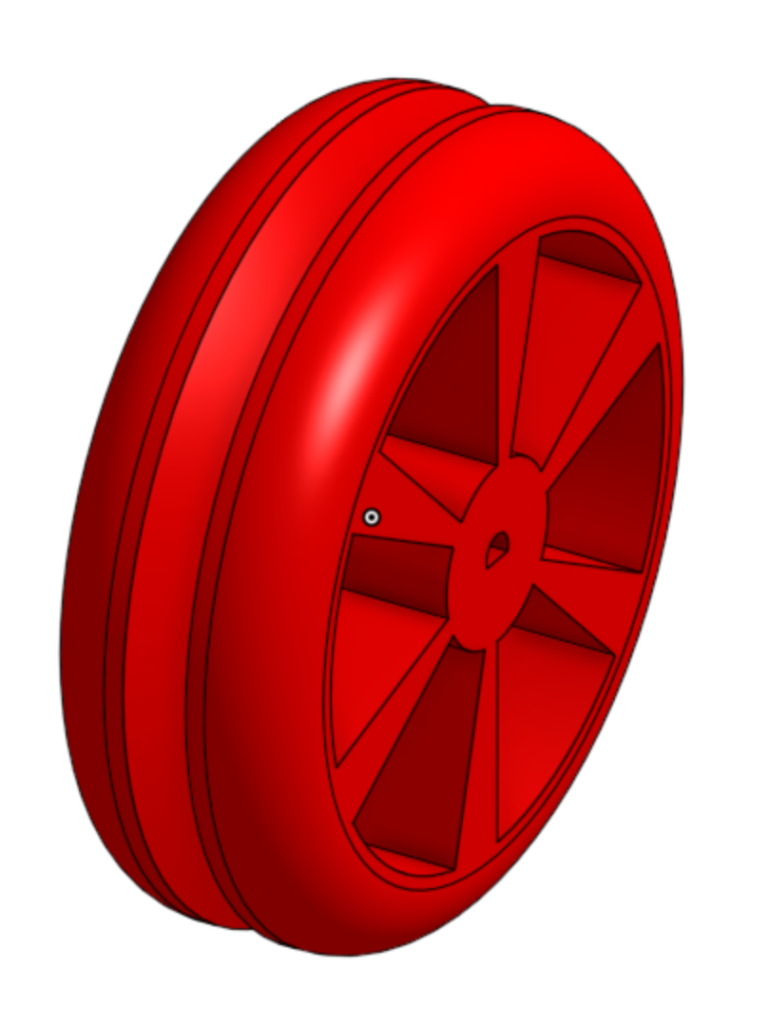
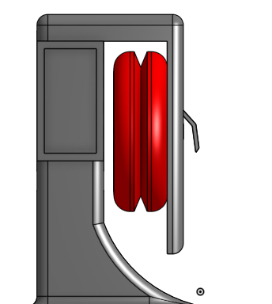
Key Features: Wheel System
Has 2 motorized wheels, both are covered. Protected from the rain by the cover.
Imperative to the mobility of the trap. Moves back and forth based on the signal from the ultrasonic sensors.
Moves slowly so that the ticks have time to get attracted to CO2 and caught by the mop.
Wheel housing
Indent to pinch wire

Slide 10
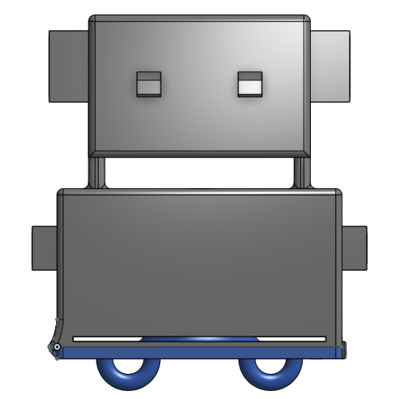
Key Features: Bump Switch
Back-up if object unnoticed by ultrasonic sensor impedes movement of trap
Serves as a failsafe for ultrasonic sensors
Bump Switch Housing

Slide 11
Questions? We are also looking for your feedback.

